Slide 1

BANK LOAN ANALYSIS
SQL QUERIES

Slide 2
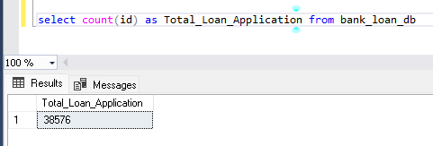
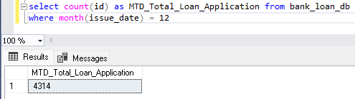

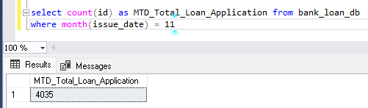
LOAN SUMMARY
TOTAL LOAN APPLICATION
MTD LOAN APPLICATION
PMTD LOAN APPLICATION

Slide 3
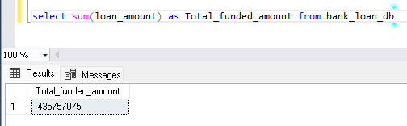
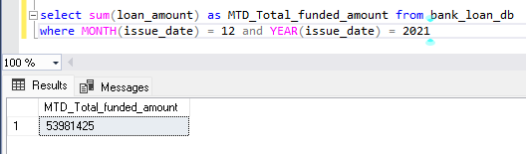
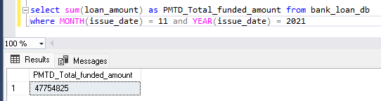
LOAN SUMMARY
TOTAL FUNDED AMOUNT
MTD TOTAL FUNDED AMOUNT
PMTD TOTAL FUNDED AMOUNT

Slide 4
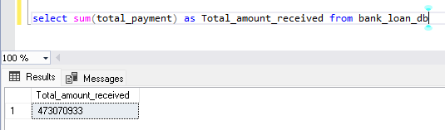
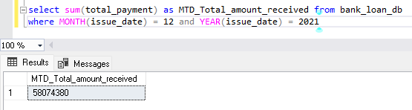
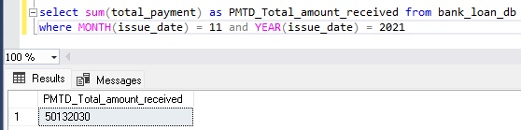
LOAN SUMMARY
TOTAL AMOUNT RECEIVED
MTD TOTAL AMOUNT RECEIVED
PMTD TOTAL FUNDED AMOUNT

Slide 5
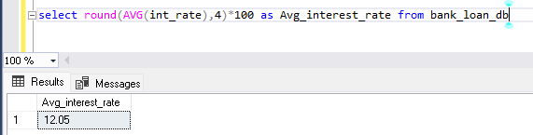
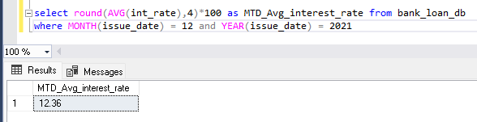
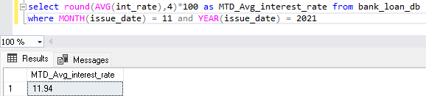
LOAN SUMMARY
AVERAGE INTEREST RATE
MTD AVERAGE INTEREST RATE
PMTD AVERAGE INTEREST RATE

Slide 6
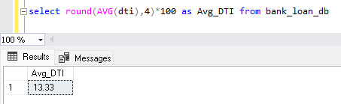
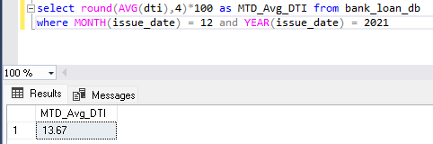
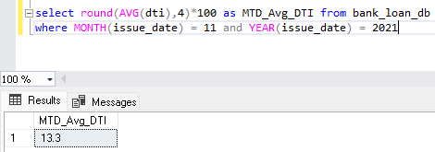
LOAN SUMMARY
AVERAGE DEPT TO INCOME RATIO (DTI)
MTD AVERAGE DTI
PMTD AVERAGE DTI

Slide 7
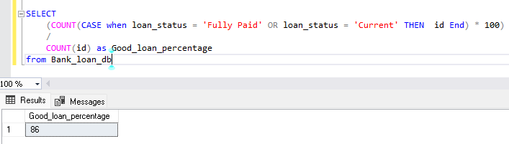
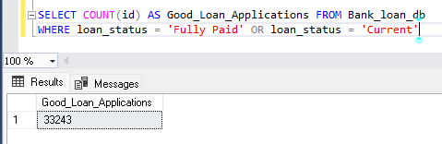
GOOD LOAN AND BAD LOAN
GOOD LOAN
1.GOOD LOAN PERCENTAGE
2.GOOD LOAN APPLICATION

Slide 8
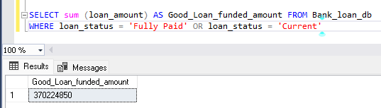
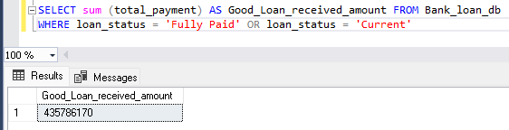
GOOD LOAN AND BAD LOAN
GOOD LOAN
3.GOOD LOAN FUNDED AMOUNT
4.GOOD LOAN TOTAL RECEIVED AMOUNT

Slide 9
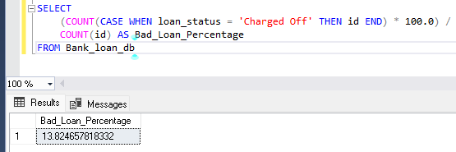
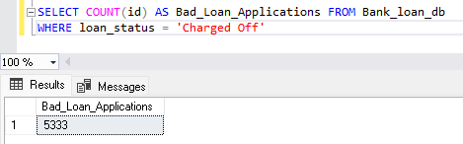
GOOD LOAN AND BAD LOAN
BAD LOAN
1. BAD LOAN PERCENTAGE
2. BAD LOAN TOTAL APPLICATION

Slide 10
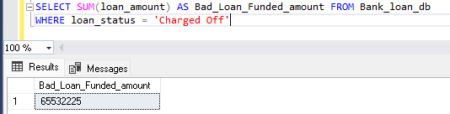
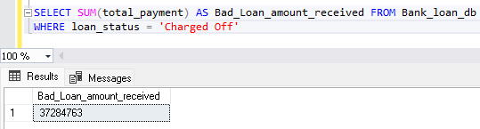
GOOD LOAN AND BAD LOAN
BAD LOAN
3.BAD LOAN FUNDED AMOUNT
4.BAD LOAN TOTAL RECEIVED AMOUNT

Slide 11
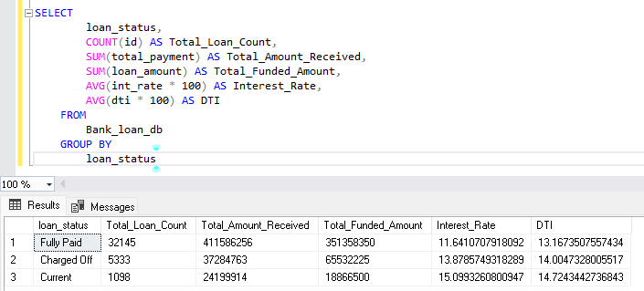
OVERALL LOAN STATUS
LOAN STATUS

Slide 12
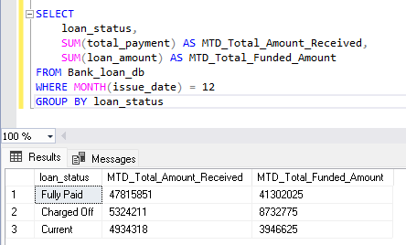
OVERALL LOAN STATUS
MTD LOAN STATUS

Slide 13
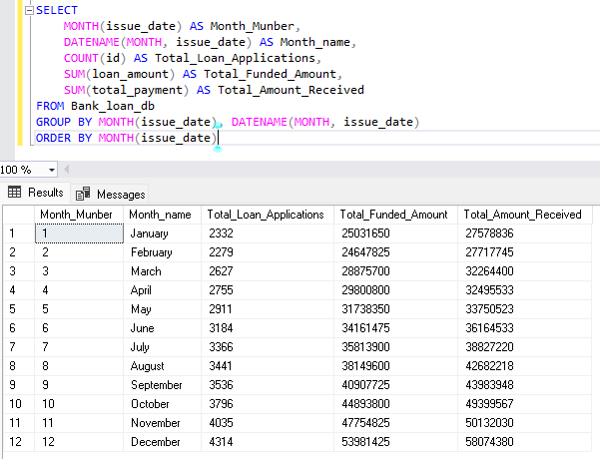
OVERVIEW
MONTHLY OVERVIEW

Slide 14
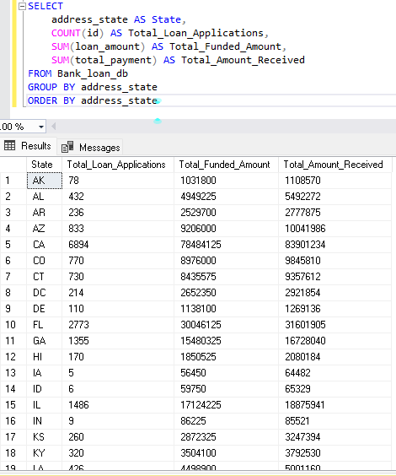
OVERVIEW
REGIONAL OVERVIEW

Slide 15
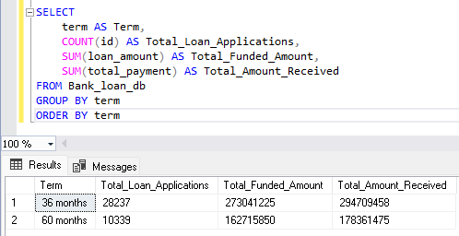
OVERVIEW
LOAN TERM ANALYSIS

Slide 16
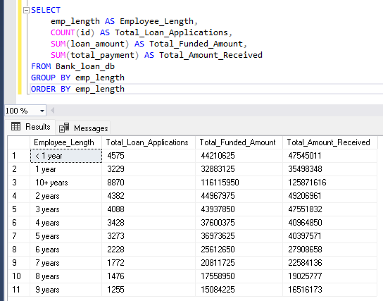
OVERVIEW
EMPLOYEE LENGTH ANALYSIS

Slide 17
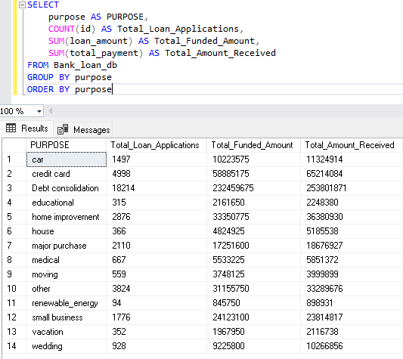
OVERVIEW
LOAN PURPOSE BREAKDOWN

Slide 18
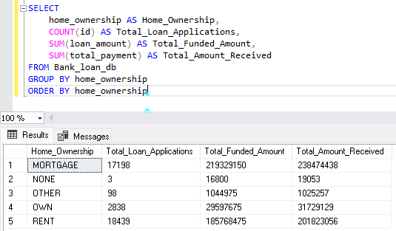
OVERVIEW
HOME OWNERSHIP ANALYSIS

